Slide 1


Cardiotocography Data to predict Fetal Health Using Machine Learning
Hyun Ko, Junghoon Kang, Kyle Yeo

Slide 2
Contents
Introduction
Methods
Outcomes
Discussion
Conclusion

Slide 3

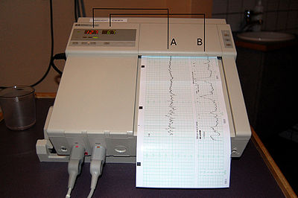
What is Cardiotocography?
WHAT IS CARDIOTOCOGRAPHY?

Slide 4
Why Cardiotocography Important?
Fetal Death takes up for 1 % of all pregnancies
Total 21,000 infant deaths, 2018, in U.S.
One of the leading causes of infant deaths is birth defects
An effective & economical preventive measure for fetal & afterbirth deaths!

Slide 5

Motivation
Predict fetal health state using Machine Learning techniques.
reduce fetal & infant mortality
reduce maternal side effects
reduce errors from misdiagnosis

Slide 6
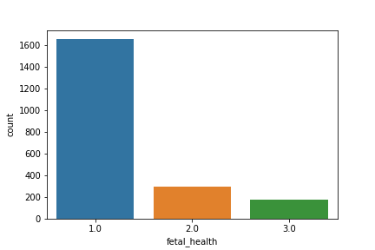
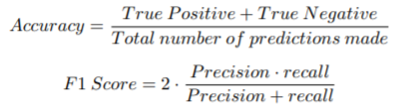
Method
Sklearn, Xgboost etc
2126 data set with 22 feature
Train Test split 70:30 & 80:20
Stratify =y

Slide 7
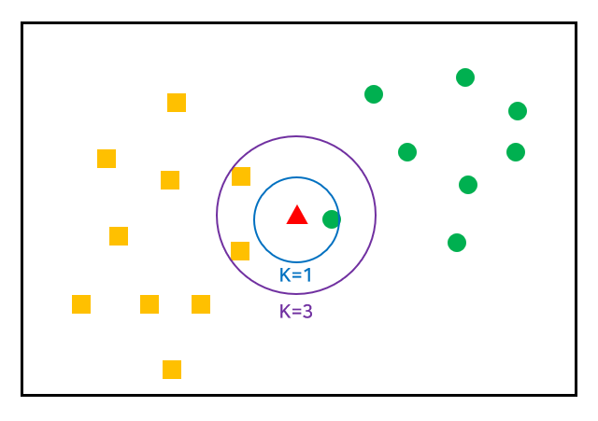
k Nearest Neighbors (kNN)
Simple and Efficient
Finding optimal k value
Used Euclidean Distance
Higher Dimension, the performance is usually poor

Slide 8

Decision Tree
Used grid search
Works well on High dimension model
Hyperparameter Setting:
“Minimum samples split”, “Max depth”
High probability of overfitting
10-fold cross validation

Slide 9
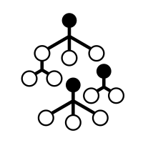
Random Forest
Avoid Overfitting
Used grid search to find best hyperparameter
Hyperparameter Setting:
‘n estimators’, ‘criterion’, ‘max depth ’
One of most widely use algorithm

Slide 10
Gradient Boosting
Latest technology
Histogram Based Gradient Boosting
Technique for faster training of gradient boost method
learning rate max depth
Xgboost
optimized with Optuna,
max depth, learning rate, lambda, alpha, n estimators
Gradient Boosting
Sensitive to parameter variables

Slide 11
Stacking
Soft Voting
Determines final value with highest probability of average value from each model
Model
Random Forest, XGboost, Decision Tree, Gradient Boost and ‘Histogram based Gradient’
Combine various model for predictions
meta-classifier: logistic regression
Voting & Stacking

Slide 12

Results and Discussions

Slide 13
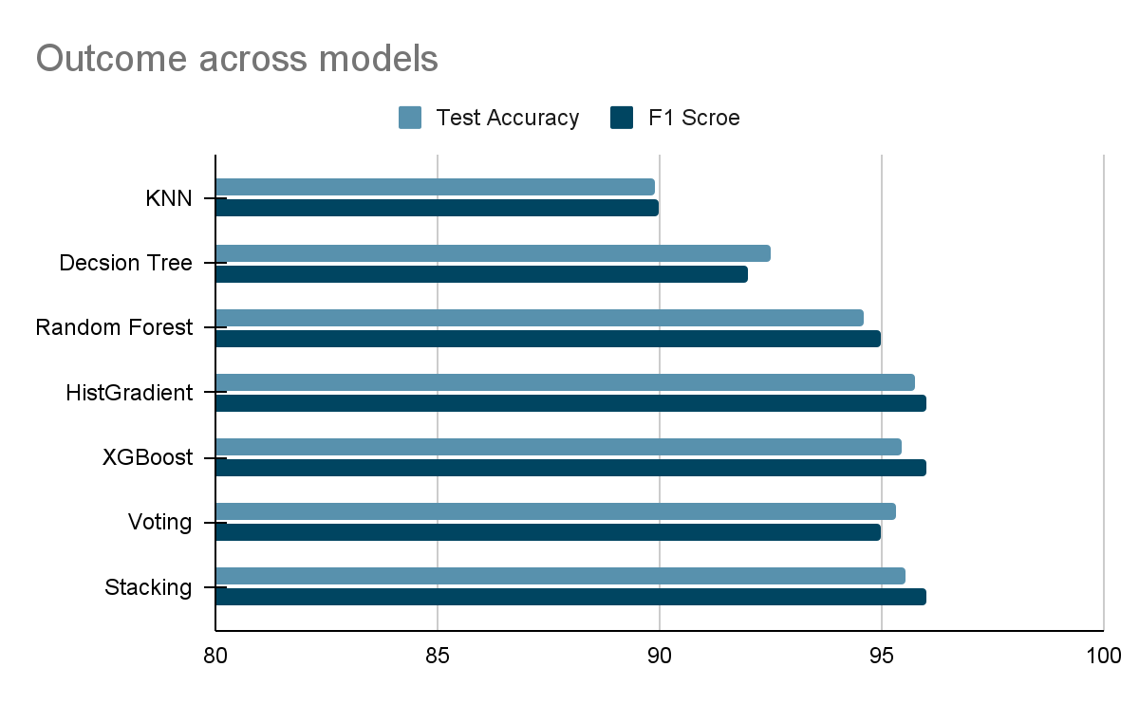
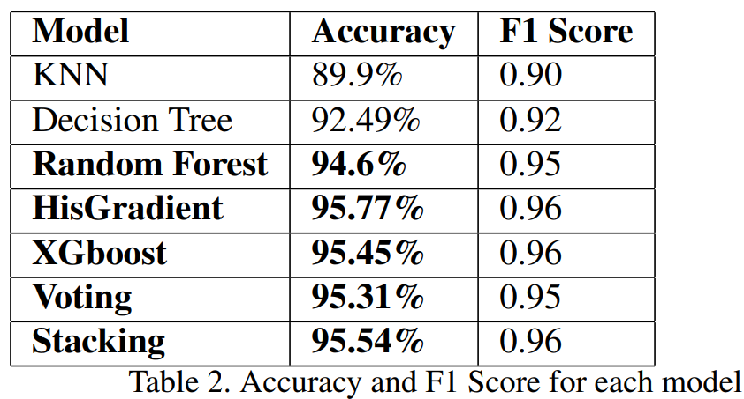
Model Performance

Slide 14
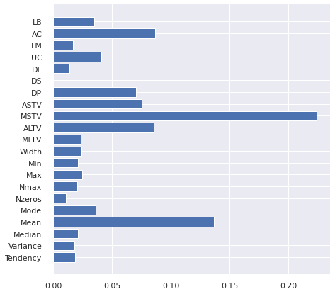
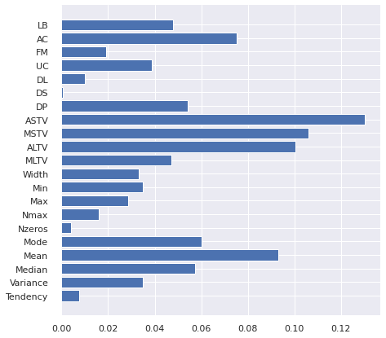
FEATURE IMPORTANCE (Random Forest vs XGBoost)
Almost same amount of information can be gained from both model
Different most important feature
Random Forest
XGBoost

Slide 15
Conclusion
Overall the models performed ideally at above 90% accuracy
Lower accuracy compared to related works, but more focused on feature interpretation
The Most Important Features
Feature selection methods can only slightly improve the result or cannot improve it at all.

Slide 16
Improvements
Search for more models (algorithms)
Search for ways to derive stronger results from K-Nearest Neighbors
Permutation feature importance analysis
Search for more effective feature extraction methods

Slide 17
Thank you

